Slide 1
Fundamental Network
Security Concepts
03

Slide 2
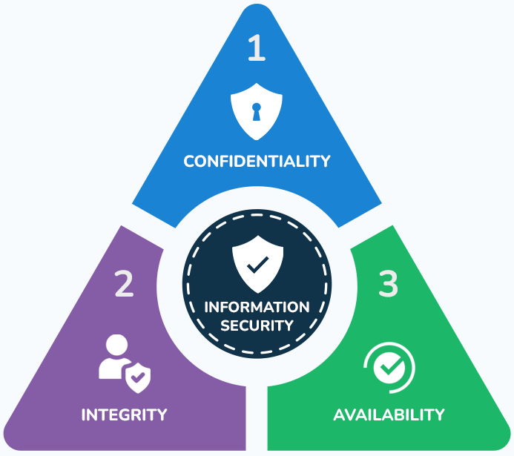
The CIA triad forms the foundation of information security
By safeguarding confidentiality, integrity, and availability, organizations can protect their critical assets and maintain business continuity.

Slide 3
Network Security
CIA Confidentiality
Protecting information from unauthorized access
Ensuring sensitive data is accessible only to authorized individuals
Examples encryption, access controls, firewalls

Slide 4
Network Security
CIA Integrity
Ensuring the accuracy and completeness of information
Preventing unauthorized modification or deletion of data
Examples hashing, digital signatures, intrusion detection systems

Slide 5
Network Security
CIA Integrity
Ensuring information is accessible when needed
Minimizing system downtime and maximizing uptime
Examples redundancy, load balancing, disaster recovery

Slide 6
Encryption Techniques
A
Asymmetric vs Symmetric
Asymmetric
Key Pair uses a pair of keys: a public key for encryption and a private key for decryption
Security extremely secure for key exchange and digital signatures, as the private key is never shared
Speed Slower than symmetric encryption, making it less suitable for large data sets
Common Algorithms: RSA (Rivest-Shamir-Adleman) and ECC (Elliptic Curve Cryptography) are popular choices
Symmetric
Single Key uses one key for both encrypting and decrypting data
Speed very fast, making it ideal for large data sets
Security highly secure if the key is kept secret, but key distribution becomes a challenge over long distances or unsecured channels
Common Algorithms AES (Advanced Encryption Standard) is the most widely used

Slide 7
Encryption Techniques
B
Key Exchange
Challenge
How to securely share the encryption key between parties without compromising its secrecy
Diffie-Hellman
Famous method where two parties can generate a shared secret key over an insecure channel.
Based on mathematical properties of modular arithmetic.

Slide 8
Encryption Techniques
C
Hybrid
Combining Strengths
Key Exchange
Data Encryption
Many systems use a combination of symmetric and asymmetric encryption
Asymmetric encryption is used to securely exchange a symmetric key
The symmetric key is then used to encrypt/decrypt the actual data, leveraging its speed

Slide 9
Encryption Techniques
D
Which to Choose?
Symmetric
Asymmetric
Hybrid
Best for large data sets where key distribution can be managed securely
Ideal for key exchange, digital signatures, and small amounts of data
Often the most practical approach, combining the best of both worlds

Slide 10
Digital Signatures and Certificates
A
Main Concept
Digital Signatures
A mathematical technique used to validate the authenticity and integrity of a digital message or document
Created using a private key to encrypt a hash of the message
The recipient verifies the signature using the sender's public key
Digital Certificates
Electronic documents issued by a trusted third-party Certificate Authority (CA)
Contain the public key of the certificate holder and information about their identity
Used to verify the authenticity of digital signatures

Slide 11
Digital Signatures and Certificates
B
Authentication and Non-Repudiation
Authentication
Verifying the identity of the sender of a message or the owner of a digital certificate
Ensures that the message or document originated from a legitimate source
Non-Repudiation
Preventing the sender of a message or the signer of a document from denying their actions
Provides legal proof of the sender's identity and intent

Slide 12
Firewalls and IDS
A
Cloud Environments
In the realm of cloud computing, security is paramount
Firewalls and Intrusion Detection Systems (IDS) are two key technologies that play a crucial role in safeguarding cloud infrastructure and applications

Slide 13
Firewalls and IDS
B
Firewall
General
Network
Application
Firewalls act as security barriers, controlling incoming and outgoing network traffic
They examine each packet of data and determine whether to allow or deny its passage based on predefined security rules
Operate at the network layer of the OSI model, inspecting traffic based on IP addresses, port numbers, and protocol types
They are well-suited for protecting the perimeter of cloud networks
Operate at the application layer, analyzing the content of traffic to identify and block malicious attacks, such as SQL injection and cross-site scripting (XSS)
Particularly useful in protecting web applications deployed in the cloud

Slide 14
Firewalls and IDS
C
IDS
General
Network-Based IDS (NIDS)
Host-Based IDS (HIDS)
Monitors network traffic and system activity for signs of malicious activity
Analyze network packets and system logs to identify potential threats, such as unauthorized access, malware, and denial-of-service (DoS) attacks
Monitor network traffic for suspicious patterns, such as unusual port scans or excessive traffic volume
Deployed at strategic points within the cloud network to capture and analyze traffic.
Monitor the activity on individual hosts, such as virtual machines or servers, to detect signs of compromise, such as unauthorized file access or unusual system behavior

Slide 15
Firewalls and IDS
D
Cloud-Specific Considerations
In cloud environments, firewalls and IDS must be adapted to the unique characteristics of cloud infrastructure
Dynamic Nature
Shared Infrastructure
Distributed Systems
Cloud environments are highly dynamic, with resources being constantly provisioned and de-provisioned
Security solutions must be able to adapt to these changes automatically
Cloud providers often share physical infrastructure among multiple tenants
Robust security measures to isolate tenants and prevent unauthorized access
Cloud applications are often distributed across multiple servers and data centers
Security solutions must be able to monitor and protect these distributed components

Slide 16
Firewalls and IDS
E
Key Challenges and Best Practices
Configuration Complexity
Evolving Threat Landscape
Performance Impact
Misconfigurations can leave systems vulnerable to attacks
Essential to implement strong configuration management practices
Cyber threats are constantly evolving
Security solutions must be updated regularly to address new vulnerabilities and attack techniques
Security solutions can impact the performance of cloud systems
Important to choose solutions that have minimal performance overhead

Slide 17
VPN
A
Introduction
A Virtual Private Network (VPN) is a technology that creates a secure, encrypted connection over a public network, typically the internet
Allows users to send and receive data privately, protecting it from potential interception and unauthorized access

Slide 18
VPN
B
How it works?
Encryption
Tunneling
Remote Access
VPNs encrypt data before it's transmitted over the network, making it unreadable to anyone who might intercept it
The encrypted data is encapsulated within a secure tunnel that traverses the public network
VPNs enable remote access to private networks, allowing users to connect to their workplace network from anywhere with an internet connection

Slide 19
VPN
C
Types
Remote Access
Site-to-Site
Cloud-Based
Allows individual users to connect to a private network from a remote location, such as their home or a public Wi-Fi hotspot
Connects two or more private networks over a public network, enabling secure communication between them
Service delivered over the internet, eliminating the need for on-premises hardware and software

Slide 20
VPN
Tunneling Protocols are the methods used to establish and maintain secure VPN connections
D
Point-to-Point Tunneling Protocol (PPTP)
Layer Two Tunneling Protocol (L2TP)
Relatively simple but less secure than newer protocols
Provides a framework for tunneling data but relies on other protocols for encryption
IPsec (Internet Protocol Security)
Secure Socket Tunneling Protocol (SSTP)
Suite of protocols that provides encryption, authentication, and integrity for IP traffic
Microsoft protocol that encrypts VPN traffic within an SSL/TLS tunnel
OpenVPN
WireGuard
Open-source protocol that offers strong security and flexibility
Relatively new protocol, known for its simplicity, speed, and security
Types

Slide 21
VPN
E
Key Benefits in Cloud Environments
Enhanced Security
Crucial role in cloud computing by providing secure access to cloud resources and protecting sensitive data
Cloud providers often offer VPN services as part of their platform, allowing users to connect to their virtual networks and resources securely
VPNs encrypt data, making it difficult for unauthorized individuals to intercept and decrypt
Anonymity
Can mask your IP address, making it harder for others to track your online activities
Remote Access
Bypassing Geo-Restrictions
Enable remote access to private networks, improving flexibility and productivity
Can help you bypass geographic restrictions and access content that may be blocked in your region

Slide 22
RBAC
A
How it works in the Cloud
Role Definition
Role Assignment
Cloud providers define predefined roles (e.g., Administrator, Developer, User) or allow organizations to create custom roles with specific permissions
Users are assigned to appropriate roles based on their job functions and responsibilities
Permission Inheritance
Access Enforcement
Users inherit the permissions associated with their assigned roles
Cloud platform enforces access controls by verifying a user's role and permissions before granting access to resources

Slide 23
RBAC
B
Least Privilege Principle
The least privilege principle dictates that users should be granted only the minimum level of access necessary to perform their tasks
This principle helps mitigate the risk of unauthorized access and data breaches

Slide 24
RBAC
C
Applying Least Privilege in Cloud Environments
Role-Based Access Control
Resource-Level Permissions
Define granular roles with specific permissions
Assign roles to users based on their job requirements
Regularly review and update role assignments to ensure they remain appropriate
Implement fine-grained access controls at the resource level (e.g., specific files, databases, virtual machines)
Limit access to resources to only those who need it
Time-Based Access Controls
Regular Review and Auditing
Implement time-based access controls to restrict access to specific time periods
Use multi-factor authentication (MFA) for additional security
Regularly review and audit access controls to identify and address potential vulnerabilities
Monitor user activity and log access attempts to detect and respond to security incidents

Slide 25
RBAC
D
Benefits
Enhanced Security
Improved Efficiency
reduces the risk of unauthorized access and data breaches
streamlines access management and reduces administrative overhead
Compliance Adherence
Scalability
helps organizations comply with regulatory requirements.
Easily adapts to changing business needs and organizational growth

Slide 26
SIEM
A
for
Cloud Security
A Security Information and Event Management (SIEM) system is a critical tool for enhancing security in cloud environments
It consolidates and analyzes security data from various sources, including cloud infrastructure, applications, and network devices
This centralized approach enables organizations to detect and respond to potential threats more efficiently

Slide 27
SIEM
B
Key Features and Benefits
Automated Incident Response
Centralized Log Management
Triggers automated responses to detected threats, such as blocking IP addresses or terminating compromised accounts
Integrates with security orchestration, automation, and response (SOAR) platforms for streamlined incident handling
Collects and aggregates logs from diverse sources (cloud providers, virtual machines, applications)
Normalizes and indexes logs for efficient search and analysis
Real-time Threat Detection
Utilizes advanced analytics and machine learning to identify anomalies and potential security breaches
Correlates events across different systems to uncover complex attack patterns
Compliance and Audit
Enhanced Visibility
Provides detailed reports and audit trails to ensure compliance with industry regulations (e.g., HIPAA, PCI DSS, GDPR)
Facilitates security audits and assessments
Offers a unified view of security posture across the entire cloud environment
Identifies security gaps and misconfigurations

Slide 28
SIEM
C
Cloud-Native Solutions
Security
Cloud-native SIEM solutions are specifically designed for cloud environments, offering the following advantages
built with robust security measures to protect sensitive data
Cost-Effectiveness
pay-as-you-go pricing models and reduced infrastructure overhead
Scalability
Performance
Easily adapts to changing workloads and data volumes
Leverages cloud infrastructure for high-performance analysis

Slide 29
SIEM
D
Choosing the
Right Solution
Scalability
Incident Response Automation
Ensure the solution can handle your organization's growing data volumes and evolving security needs
Support automated response actions to minimize the impact of security incidents
Integration Capabilities
Compliance and Reporting
SIEM should integrate seamlessly with your cloud infrastructure, security tools, and identity and access management (IAM) systems
Should provide comprehensive reporting and auditing capabilities to meet regulatory requirements
Threat Detection Capabilities
User Interface and Experience
Look for advanced analytics, machine learning, and behavioral analytics features to detect sophisticated threats
User-friendly interface can significantly improve security analysts' efficiency

Slide 30
IRDR
In today's cloud-centric world, ensuring business continuity and minimizing downtime in the face of incidents or disasters is paramount
Incident Response
Coordinated set of procedures to detect, analyze, and contain security breaches or other IT incidents
A robust Incident Response and Disaster Recovery (IRDR) strategy is essential for organizations leveraging cloud services
Disaster Recovery
Plan to restore IT systems and operations in the event of a disaster, such as a natural disaster or cyberattack

